Slide 1


Team Maverick’s
AI-driven Solution
PRESENTED BY:
Bhaskar
Pranav
Shardul
Varin

Slide 2
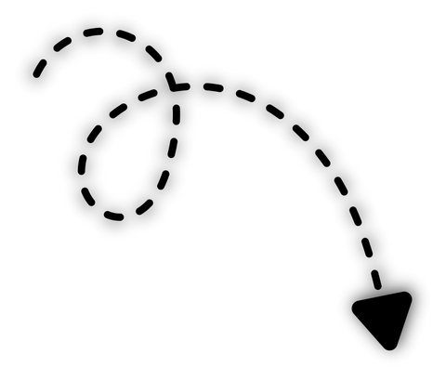

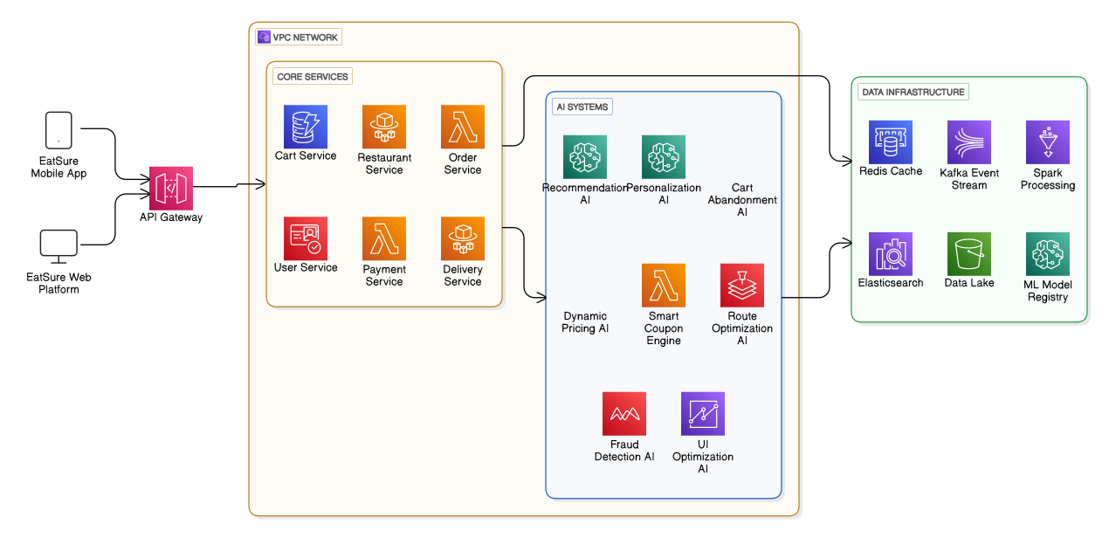




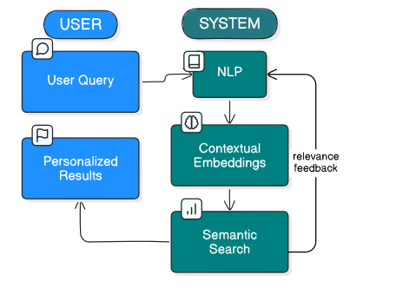

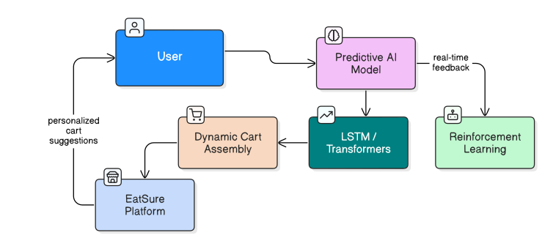
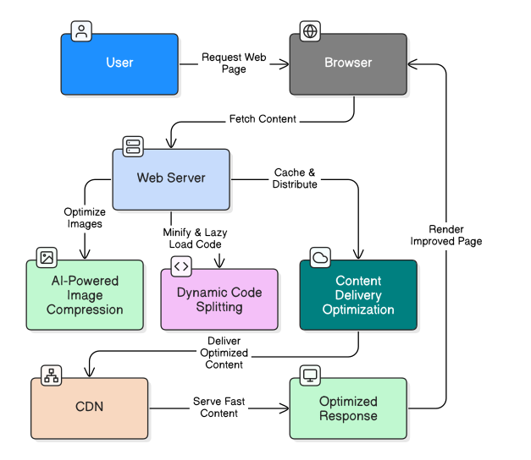
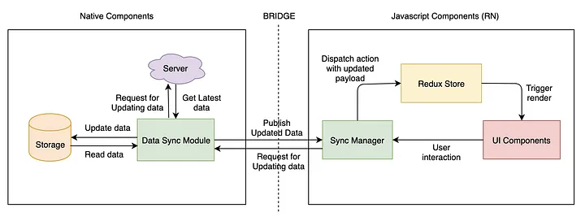
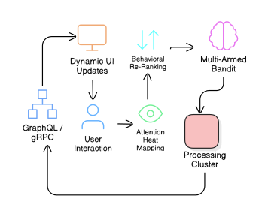
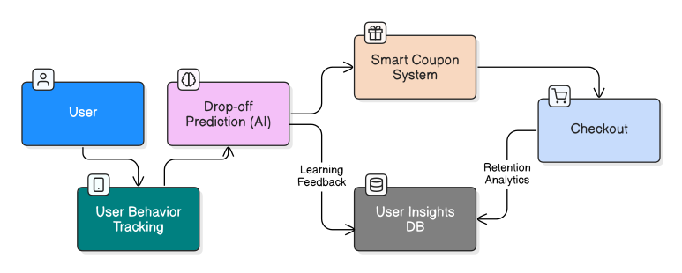

Problem Insight & Proposed System Architecture
Native Components: Handle core functionalities like data synchronization, analytics, fraud detection, and system utilities, structured into multiple layers.
JavaScript Components: Manage UI interactions, state synchronization via Redux, and logging/monitoring, interfacing with native modules through the React Native Bridge.
Reduce cart processing time (CPT) (from app login to checkout) to improve efficiency and customer satisfaction.
AIM
CART PROCESSING TIME ANALYSIS
Issue : Item Selection for Cart
Issue : Lack of Personalization
Solution: Hyper Personalized Neural Search (by Custom LLM trained on 50M+ food items to answer conversational queries like “What should I eat after workout”
Solution: AI-driven Predictive Cart Assembly system to leverage time series forecasting, deep learning (LSTM, Transformers), and reinforcement learning to predict and pre-fill carts based on user history, time of day, and behavioral patterns.
Issue : Static UI Optimization
Solution :A server-driven UI adapts in real-time using attention heat mapping, optimizing layout via behavioral re-ranking and Multi-Armed Bandit models, with GraphQL/gRPC delivering dynamic UI updates.
Issue : Bad Website Performance
Solution: AI-powered image compression, code splitting, and CDN optimization for improved performance
Issue : Cart Dropping By User
Solution: An AI-based model which tracks user journey from opening the app to placing the order. The model shall recognize the phase where the user is most likely to leave the app and shall suggest coupons at that stage to keep the user hooked.
Component Layers:
Divided into multiple layers: Business Intelligence, Application Core, Frameworks/Modules, and Commons.
Ensures modular development and separation of concerns.
React Native Bridge Integration:
Connects UI Components with the Backend Data Sync and Redux Store.
Facilitates interaction between native modules and JavaScript components for real-time updates.

Slide 3









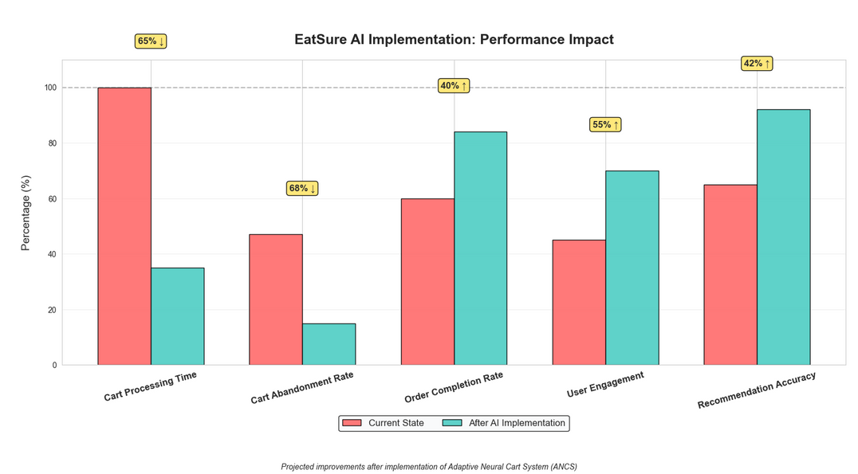

Development Plan, Resource Estimates & Success Metrics
Development Plan
Resource Estimates
HIGH-LEVEL API FOR TENSORFLOW TO SPEED UP NEURAL NETWORK DEVELOPMENT
Financial Investment
Artificial Intelligence & Machine Learning Infrastructure: ₹1.5-2 Crore
Cloud Computing Resources: ₹80 Lakhs-1 Crore
Development Team Costs: ₹1.06-1.66 Crore
Other Development Costs: ₹40-60 Lakhs
Contingency Budget: ₹30-50 Lakhs
Total Project Investment: ₹5.76 Crore
Research and Design
Focus: Cart Abandonment Rate (-68%)
DEEP LEARNING FRAMEWORKS FOR BUILDING AND OPTIMIZING RECOMMENDATION ALGORITHMS
User journey mapping and bottleneck identification
AI model selection and prototype development
Establish baseline measurements for all KPIs
1
Duration
1 month
AI tools
Deliverable:
Comprehensive user journey map with identified friction points
VERSIONING AI DATASETS
MODEL TRACKING AND DEPLOYMENT AUTOMATION
Manpower Estimates
AI Architects – Neural network specialists who will craft our recommendation algorithms and personalization engines
Integration Engineer – The vital bridge between AI models and EatSure's existing systems
Experience Developer – Translates AI capabilities into intuitive front-end interactions
Cloud Infrastructure Strategist – Designs scalable architecture that grows with user demand
End of Phase 1
MVP Implementation
Focus: Cart Processing Time (-65%)
Core recommendation
engine development
Personalization
Algorithm implementation
A/B-testing with 5% user base
Optimize Checkout Algo
2
Duration
2 months
Deliverable:
Functional MVP with 20-30% improvement in processing time
Success Metrics
Expected Results
Cart Processing Time (-65%):
Time from app open to checkout completion
Cart Abandonment Rate (<15%):
Users who abandon items in cart
Order Completion Rate (+40%):
Successfully completed transactions
User Engagement (+55%):
Weekly active user interactions
Recommendation Accuracy (92%):
Personalized suggestion relevance
Focus:
Order Completion Rate (+40%)
User Engagement (+55%)
Recommendation Accuracy (+42%)
Full Deployment
End of Phase 2
Full-platform implementation
and integration
System optimization and API development
A/B testing and iterative improvements
Performance monitoring and adjustments
3
Duration
4 months
Deliverable:
Fully deployed system meeting all KPI targets
Completion

Slide 4

Detailed Development Plan
Research and Design
MVP Implementation
Research and Design
Focus:
Help and Support
Slow Delivery
Focus:
Cart Abandonment Rate
Cart Processing Time
Identify further problems
Focus:
Cart Abandonment Rate
Cart Processing Time
Help and Support
Slow Delivery
User journey mapping and
bottleneck identification
Help and Support
User Engagement
Use NLP to check if there are any particular complaints via app store reviews /surveys / other modes
Segment journey into phases and check which phase has highest drop off rate
Auto Resolutions for low-risk cases using business rules.
Real-Time Context Awareness from order data and delivery status.
Evidence Handling via image uploads and metadata checks.
Smart Escalations triggered by sentiment and case complexity.
Feedback-Driven Learning to continuously refine support logic.
Personalized food recommendations (Swiggy Sixes, Zomato Flash Sale)
Focus on number of returns
Classify restaurants based on reviews and flag them for improvement.
If order cancelled due to delivery issues, then focus on the “Slow Delivery” point
1
2
Establish baseline measurements for all KPIs
Slow Delivery
Recommendation Accuracy
Cart Processing Time - self explanatory
Cart Abandonment - Step-by-Step Abandonment Rate
User Engagement - Number of Returns
Recommendation Accuracy - Revenue from such items
3 key factors - Resto proximity , Rider assigned , and Prep Time.
Use XGBoost/ Random forest to check whether order will be on time or likely to be delayed.
Input data to model: Historical multi-resto orders, assigned delivery time, actual delivery time
Include rush factor
Use Ranking Model for relevant items [P(add) + profit margin]
Offer micro-discounts
A/B Testing + ML to learn best layout and screen
Deliverable:
Comprehensive user journey map with identified friction points
Deliverable:
Comprehensive user journey map with identified friction points
Deliverable:
Comprehensive user journey map with identified friction points
End of Phase 1
End of Phase 2.1
End of Phase 2.2
Duration 1 month
Duration 1 month
Duration 1 month

Slide 5
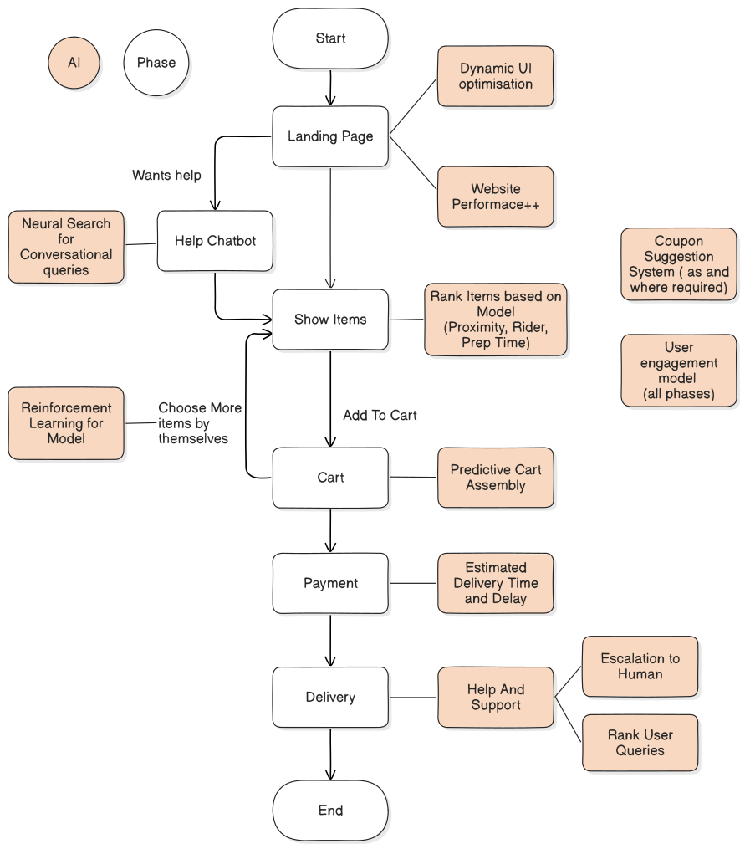
Detailed Development Plan
High Level View
Foundation
Personalization
Deploy containerized microservices architecture
Integrate ranking algorithm with product database
Set up user behavior tracking system
Implement basic chatbot functionality
Configure delivery zone management
Configure existing recommendation models with reinforcement learning
Implement user-specific personalization
Optimize API response times
Deploy existing context-aware help system
Integrate existing coupon suggestion system
3
Intelligence Layer
Scale And Refinement
Deploy existing ML models for item ranking
Implement existing predictive cart assembly
Establish A/B testing infrastructure
Integrate pre-built delivery prediction system
Create performance monitoring dashboards
Fine-tune deployed ML models with production data
Implement automated anomaly detection
Complete performance optimization
Deploy end-to-end engagement tracking
Establish continuous improvement framework

Slide 6



Potential Challenges & Mitigation Strategies
Issue: AI Accuracy & Performance
Issue: Technical Integration with current capabilities
Issue: Data Privacy & Security
Challenges:
Building AI models that provide truly relevant recommendations
Cold start problem for new users with limited history
Maintaining real-time performance at scale
Challenges:
Integrating AI systems with existing legacy infrastructure
Ensuring smooth data flow between components
Managing backend-frontend communication efficiently
Challenges:
Collecting and processing user behavior data raises privacy concerns
Compliance with data protection regulations (like GDPR)
Securing sensitive payment information
Mitigation Strategies:
Use hybrid recommendation systems (collaborative + content-based)
Implement A/B testing frameworks to continuously optimize models
Develop fallback mechanisms for new users (category-based recommendations)
Set up model monitoring dashboards to detect performance degradation
Establish regular model retraining pipelines
Mitigation Strategies:
Create well-defined APIs for system integration
Implement event-driven architecture for real-time updates
Develop comprehensive documentation for all integration points
Use feature flags to gradually roll out new capabilities
Establish a robust CI/CD pipeline for seamless deployment
Mitigation Strategies:
Implement data anonymization techniques
Deploy end-to-end encryption for all user data
Establish clear consent mechanisms for data collection
Conduct regular security audits and penetration testing
Develop a comprehensive privacy policy
Issue: Cost Management and Allocation
Issue: Scalability & Performance
Issue: User Adoption & Experience
Challenges:
Balancing development costs with expected ROI
Managing ongoing cloud infrastructure expenses
Controlling costs for AI/ML model training and inference
Challenges:
Handling peak traffic during high-demand periods
Minimizing latency for real-time recommendations
Ensuring system stability under increasing user load
Challenges:
User resistance to AI-powered recommendations
Balancing automation with user control
Avoiding UI complexity with new features
Mitigation Strategies:
Implement cost monitoring and optimization tools
Use serverless computing where appropriate to reduce idle resources
Establish clear budget thresholds and alerts
Balance model complexity with operational costs
Prioritize features based on ROI potential
Mitigation Strategies:
Design cloud-native architecture with auto-scaling capabilities
Implement caching mechanisms for frequently accessed data
Use CDN for content delivery optimization
Adopt microservices architecture for independent scaling
Establish load testing as part of the development pipeline
Mitigation Strategies:
Implement gradual rollout with user feedback loops
Design intuitive UI that makes AI recommendations feel natural
Provide clear explanations for recommendations
Allow users to easily modify or override AI suggestions
Create onboarding experiences highlighting new features
In the pursuit of reducing cart processing time and enhancing user experience, this case study demonstrates how AI can transform operational efficiency at EatSure. By addressing core challenges like non-personalized recommendations, UI friction, and payment delays, and proposing structured mitigation strategies, the solution ensures both scalability and cost-effectiveness.

Slide 7



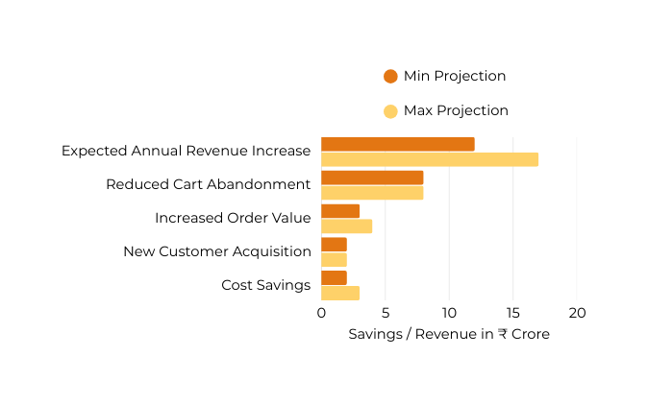
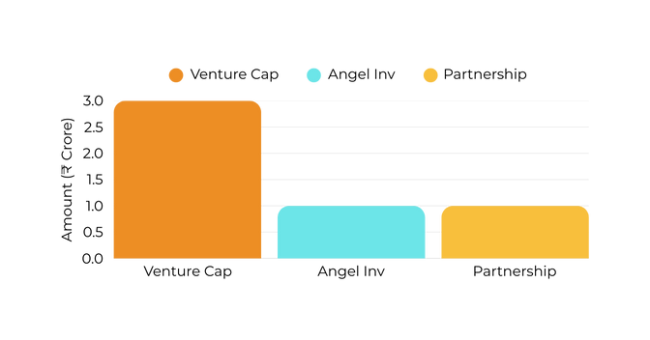
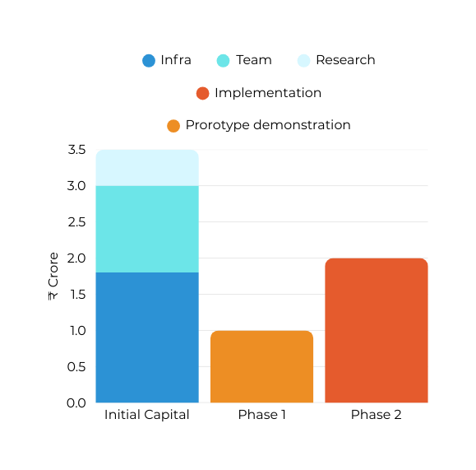

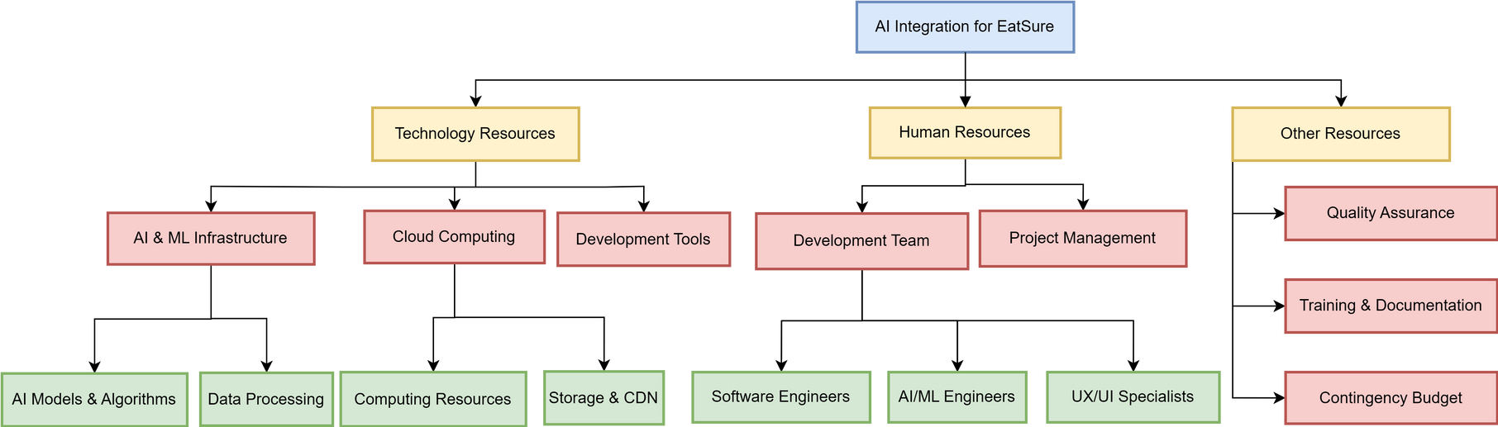









Funding/Resource Breakdown
Investment Sources
Venture Capital: ₹3.0 Crore (Series A funding)
Focus on AI/ML specialized VCs like Sequoia India, Accel, and Blume Ventures
Angel Investors: ₹1.0 Crore (Early-stage capital)
Consortium of 4-5 industry experts with food-tech experience
Strategic Partnership: ₹1.0 Crore (Co-development funding)
Technology partnership with major cloud provider (AWS/Azure/GCP)
ROI Projections
Payback Period: 18-24 months
Projected 3-Year ROI: 200% (₹11.52 Crore return on ₹5.76 Crore investment)
Cost Savings: ₹2-3 Crore annually through operational efficiencies
Financial Structure
Initial Capital Requirement: ₹3.5 Crore (60% of total)
Development infrastructure: ₹1.8 Crore
Team onboarding: ₹1.2 Crore
Research & initial prototyping: ₹0.5 Crore
Milestone-Based Releases: ₹2.26 Crore (remaining 40%)
Phase 1 Completion: ₹0.76 Crore (Research and design phase focused on user journey mapping, bottleneck identification, and AI model selection with a functional prototype demonstrating 15% CPT improvement.)
Phase 2 Completion: ₹1.5 Crore (MVP implementation phase delivering a fully integrated solution with personalized recommendations and dynamic UI optimizations achieving 20-30% improvement in cart processing time.)
Resource Breakdown Structure

Slide 8
THANK YOU
PRESENTED BY:
Bhaskar
Pranav
Shardul
Varin

